Slide 1
Functions modules and data manipulation

Slide 2
Contents
Functions
Modules
Data Manipulation

Slide 3
Functions
Python Functions is a block of statements that return the specific task. The idea is to put some commonly or repeatedly done tasks together and make a function so that instead of writing the same code again and again for different inputs, we can do the function calls to reuse code contained in it over and over again.
Some Benefits of Using Functions
Increase Code Readability
Increase Code Reusability

Slide 4
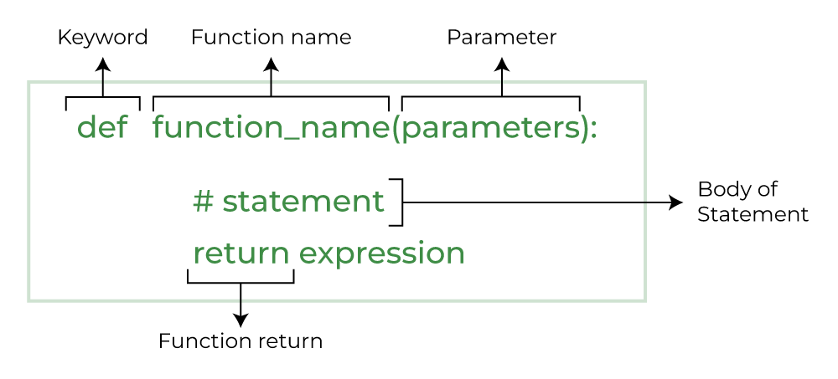
Python Function Declaration
The syntax to declare a function is:

Slide 5
Types of Functions in Python
There are mainly two types of functions in Python.
Built-in library function: These are Standard functions in Python that are available to use.
User-defined function: We can create our own functions based on our requirements.

Slide 6
Creating a Function in Python
We can create a user-defined function in Python, using the def keyword. We can add any type of functionalities and properties to it as we require.
Calling a Python Function
After creating a function in Python we can call it by using the name of the function followed by parenthesis containing parameters of that particular function.

Slide 7
Python Function Arguments
Arguments are the values passed inside the parenthesis of the function. A function can have any number of arguments separated by a comma.
Types of Python Function Arguments
Python supports various types of arguments that can be passed at the time of the function call. In Python, we have the following 4 types of function arguments.
Default argument
Keyword arguments (named arguments)
Positional arguments
Arbitrary arguments (variable-length arguments *args and **kwargs)

Slide 8
Modules
A Python module is a file containing Python definitions and statements. A module can define functions, classes, and variables. A module can also include runnable code. Grouping related code into a module makes the code easier to understand and use. It also makes the code logically organized.
Built in Modules
Python's standard library comes bundled with a large number of modules. They are called built-in modules. Most of these built-in modules are written in C (as the reference implementation of Python is in C), and pre-compiled into the library. These modules pack useful functionality like system-specific OS management, disk IO, networking, etc.

Slide 9
Some important python modules:
1 | os This module provides a unified interface to a number of operating system functions.
2 | string This module contains a number of functions for string processing
3 | re This module provides a set of powerful regular expression facilities. Regular expression (RegEx), allows powerful string search and matching for a pattern in a string
4 | math This module implements a number of mathematical operations for floating point numbers. These functions are generally thin wrappers around the platform C library functions.
5 | cmath This module contains a number of mathematical operations for complex numbers.
6 | datetime This module provides functions to deal with dates and the time within a day. It wraps the C runtime library.
7 | gc This module provides an interface to the built-in garbage collector.
8 | asyncio This module defines functionality required for asynchronous processing

Slide 10
User Defined Modules
Any text file with .py extension and containing Python code is basically a module. It can contain definitions of one or more functions, variables, constants as well as classes. Any Python object from a module can be made available to interpreter session or another Python script by import statement. A module can also include runnable code.
The import Statement
In Python, the import keyword has been provided to load a Python object from one module. The object may be a function, class, a variable etc. If a module contains multiple definitions, all of them will be loaded in the namespace.

Slide 11
Data Manipulation
Data manipulation with python is defined as a process in the python programming language that enables users in data organization in order to make reading or interpreting the insights from the data more structured and comprises of having better design. For example, arranging the employee’s names in alphabetical order will enable quicker searching of a particular employee by their name. The key feature of data manipulation is enabling faster business operations and also emphasize optimization in the process. Through proper manipulated data one can analyze trends, interpret insights from financial data, analyze consumer behaviour or pattern, etc. Not only the analyzing, but it also enables users to neglect any unnecessary data in the set so that one can save space and only fill the limited space with important and necessary data.

Slide 12
Python provides a wide range of techniques for manipulating data. Some of the most commonly used techniques are:
Filtering - used for selecting a subset of the data based on a condition. This is done using boolean indexing or the query function.
Aggregation - used for computing summary statistics, such as mean, median, and standard deviation. This is done using the groupby function.
Sorting - used for sorting the data based on one or more columns. This is done using the sort_values function.
Joining - used for combining multiple data sources based on a common key. This is done using the merge function.
Reshaping - used for transforming the data from one shape to another. This is done using the pivot, melt, and stack/unstack functions.

Slide 13
Libraries for Data Manipulation
The presence of python libraries like Numpy and Pandas give analysts the power to manipulate data with ease by providing sets of tools, that can be used to perform a range of actions on data: from organization to performance of arithmetic operations to visualization, among others.
Numpy and Pandas both provide tools for processing multidimensional data structures like arrays, and even better, generic data.

Slide 14
Python Numpy Library
Numpy is a general-purpose array processing package that provides a high-performance multidimensional array object, and tools for working with these arrays. These arrays are called ndarrays and have the following properties:
Rank — number of dimensions of the array
Shape — tuple of integers giving the size of the array along each dimension
dtype — datatype of the array

Slide 15
Python Pandas Library
Pandas revolves around a structure called DataFrame. A dataframe is a 2-dimensional structure, that is, it structures the data along two axes: x and y. The x-axis maps to the rows while the y-axis maps to columns. In short, dataframes provide a table-like structure with columns that could be of different types.

Slide 16
THANK YOU

